Slide 1
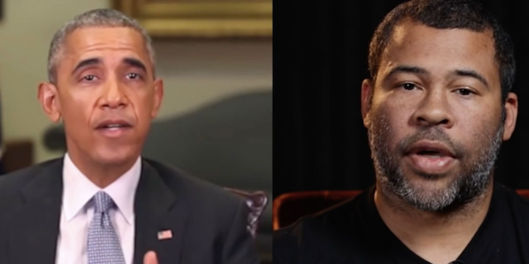
Deepfakes and Detection
姜育刚，马兴军，吴祖煊

Slide 2
Recap: week 9
Membership Inference Attack
Differential Privacy

Slide 3
This Week
General Tampering（一般数据篡改）
Deepfake（深度伪造，图像）
Deepfake Videos（深度伪造，视频）
Detection

Slide 4
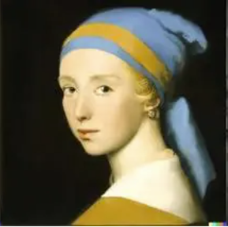
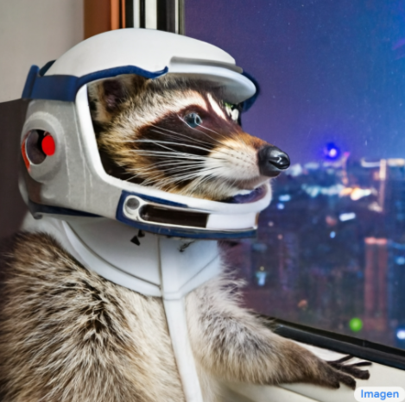

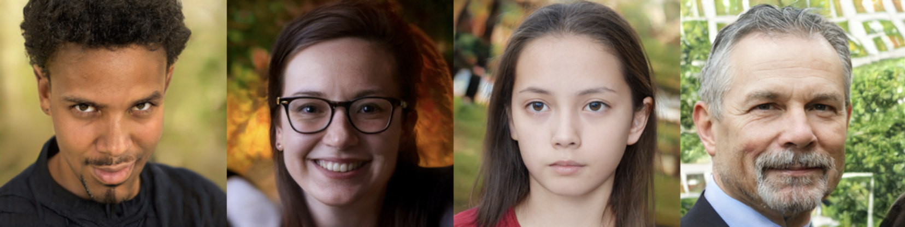
Significant Progress in Computer Vision
DALL·E 3
OpenAI
Text2Image,
Image Editing…
Imagen 2
Google
Text2Image, Text2Vedio
Stable Diffusion 3
Stability AI
Text2Image,
Image Editing…
This person does not exist, https://thispersondoesnotexist.com/

Slide 5
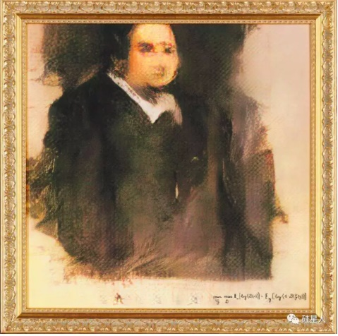
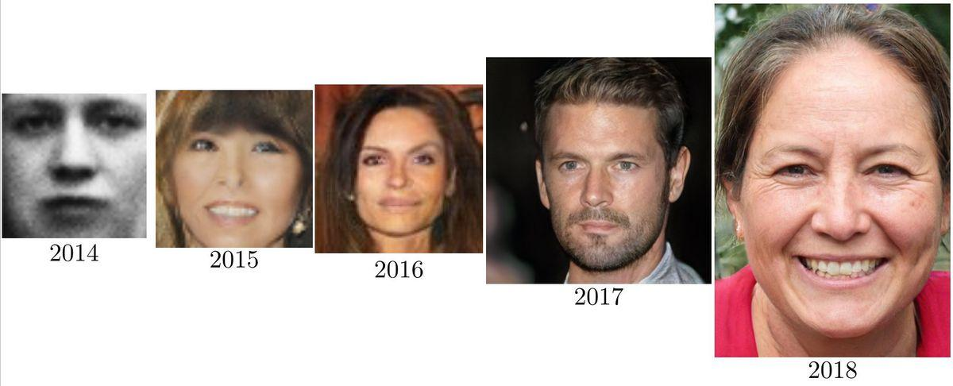
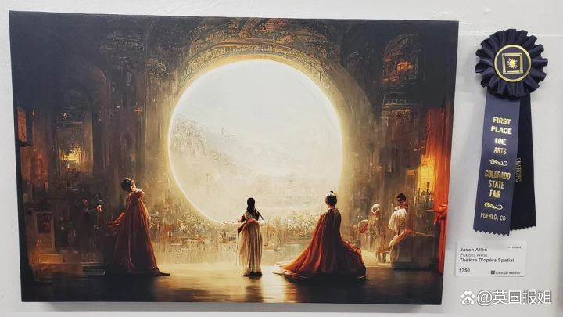
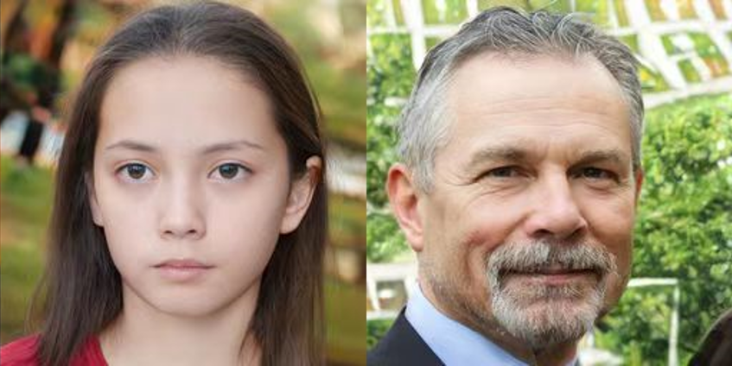
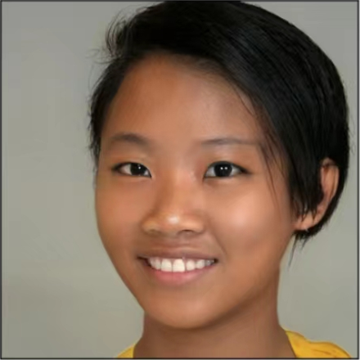
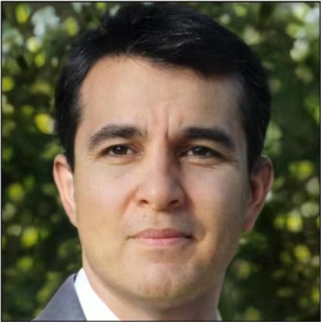
Significant Progress in Computer Vision
The resolution and fidelity of generated face images are constantly improving.
An AI-generated portrait sold for $432,000 at the Christie‘s (2018)
2019
2021
AI artwork won first prize in art competition.(2022)
Notes:
Christie‘s(佳德士拍卖会)

Slide 6
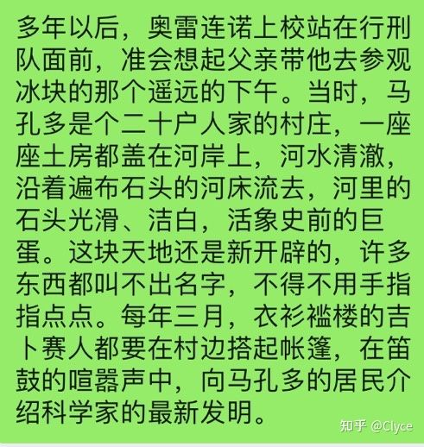
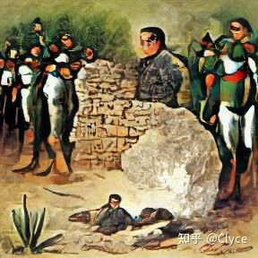
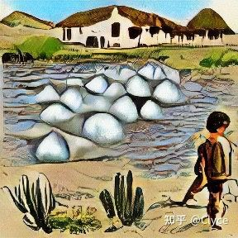
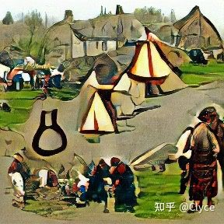
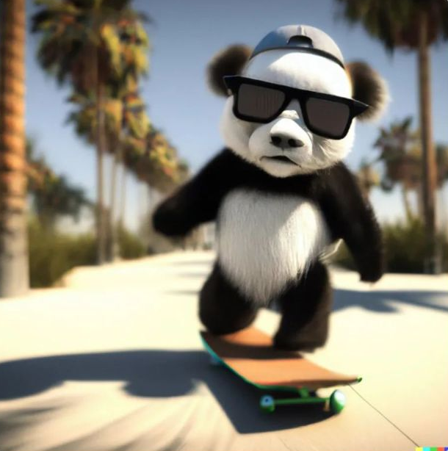
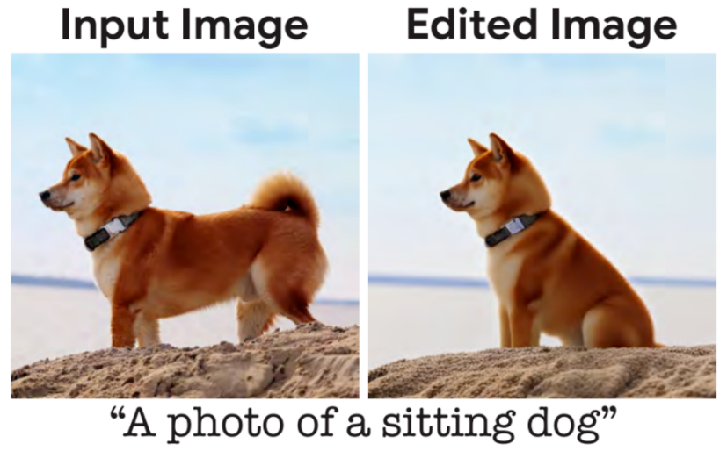
Significant Progress in Computer Vision
Generate an image using the first paragraph of "One Hundred Years of Solitude" (2021)
DaLL·E2（2022）
Generate an image based on text: “I have always wanted to be a cool panda riding a skateboard in Santa Monica.”
Imagic（2022）
Edit images with text.

Slide 7
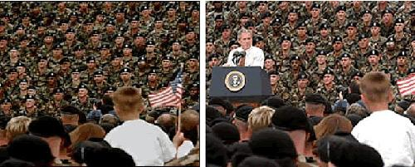
Data Tampering and Forgery
Definition：Tamper images and videos with variety of techniques, such as deepfakes.
According to the content and type of the tampered data: general tampering & face forgery.
A fake image about Bush Jr. election

Slide 8
This Week
General Tampering
Deepfake
Deepfake Videos
Detection

Slide 9
General Tampering
Definition: tamper the original image by adjusting the spatial position of objects, replacing the original content with forged content (style modification, texture transformation, image restoration…)
Taxonomy
Context-based
tamper foreground objects
tamper image background
Conditioned
Text-guided image tampering

Slide 10
General Tampering
？
Core Problem：how to decouple different elements in an image?
(Foreground & Background, Texture & Structure, …)
Model different elements in the image: the shape of objects, the interaction between objects and their relative positions, …

Slide 11
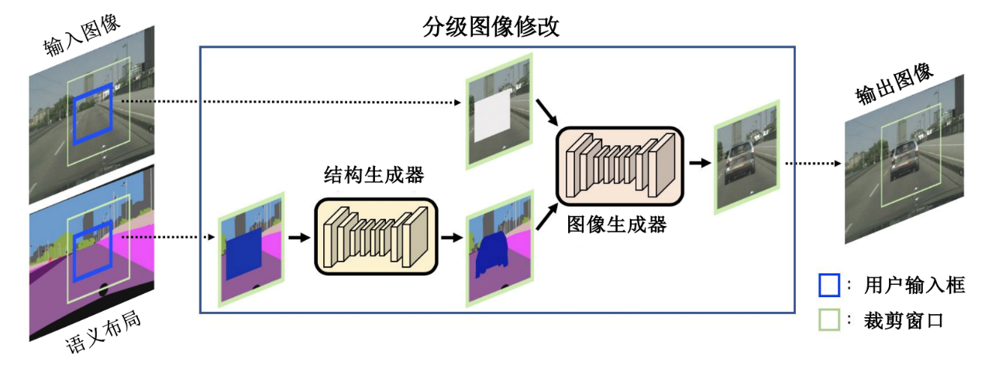
Foreground Tampering
Construct object-level semantic segmentation maps
Hong, S et al. Learning hierarchical semantic image manipulation through structured representations. NeurIPS, 2018.

Slide 12
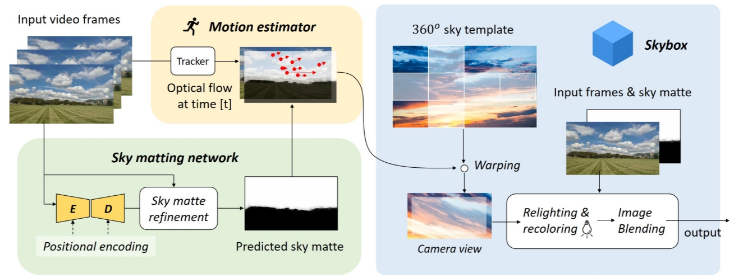
Background Tampering
the background can be viewed as a larger object
Zou, Z et al. Castle in the sky: dynamic sky replacement and harmonization in videos. IEEE Transactions on Image Processing. 2022.

Slide 13
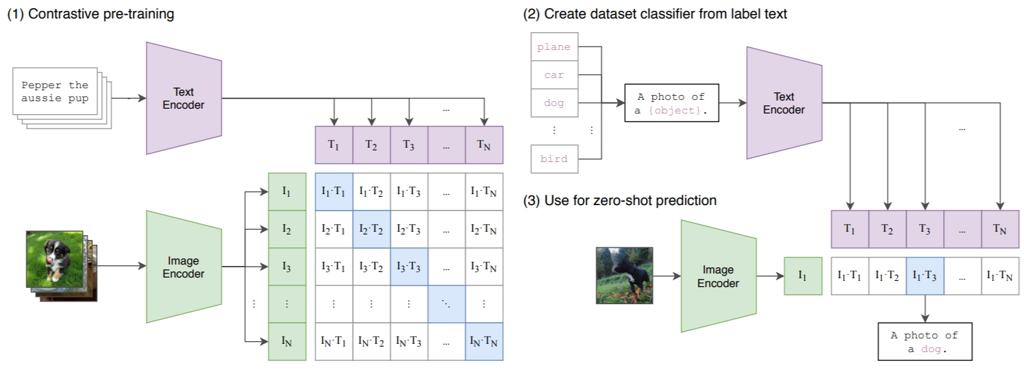
Text-guided Tampering | CLIP
Radford, A. et al. Learning transferable visual models from natural language supervision. ICML, 2021.

Slide 14
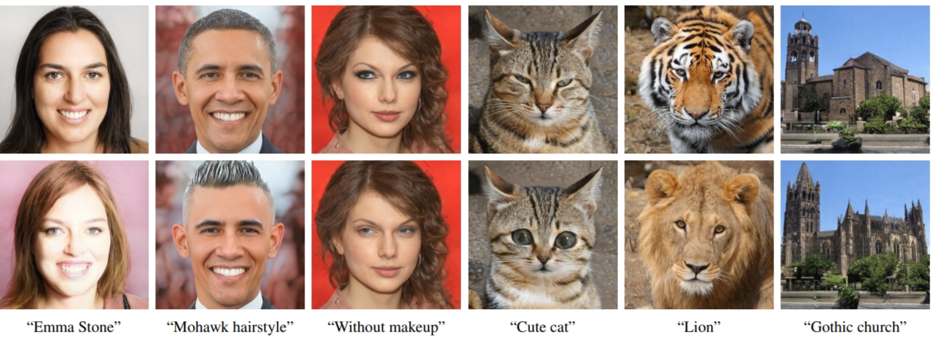
Text-guided Tampering | CLIP + StyleGAN
Patashnik, O. et al. Styleclip: text-driven manipulation of stylegan imagery. ICCV, 2021.

Slide 15
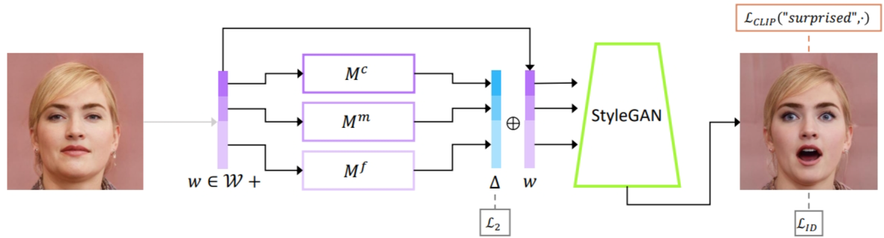
Text-guided Tampering | StyleGAN
target code
Residual code
Latent code
Mapping function
Patashnik, O. et al. Styleclip: text-driven manipulation of stylegan imagery. ICCV, 2021.
Notes:
The architecture of the text-guided mapper (using the text prompt “greyhair”, in this example). The source image (left) is inverted into a latent code w. Three separate mapping functions are trained to generate residuals (in blue) that are added to w to yield the target code, from which a pretrained StyleGAN (in green) generates an image (right), assessed by the CLIP and identity losses.

Slide 16
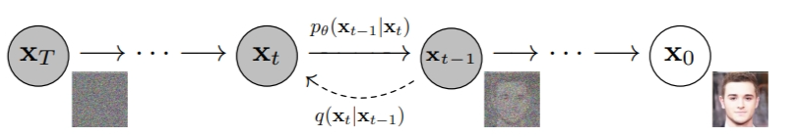
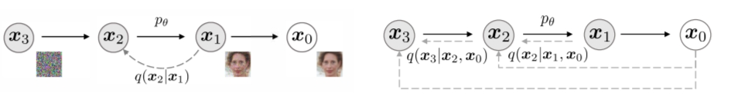
Text-guided Tampering | Diffusion
The directed graphical model of DDPM
Graphical models for diffusion (left) and non-Markovian (right) inference models
Ho, J. et al. Denoising diffusion probabilistic models. NeurIPS, 2020.
Song, J. et al. Denoising diffusion implicit models. ICLR, 2022.

Slide 17
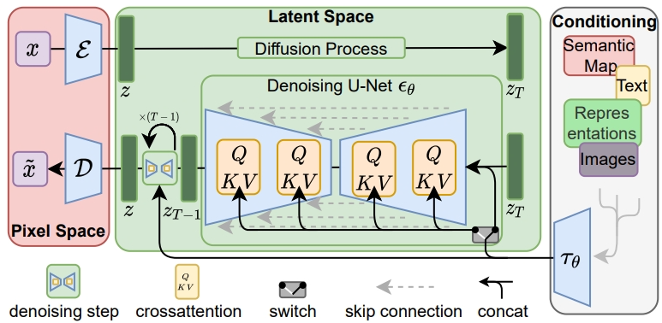
Text-guided Tampering | CLIP + Diffusion
Stable Diffusion
Rombach R. et al. High-resolution image synthesis with latent diffusion models, CVPR, 2022.

Slide 18
This Week
General Tampering
Deepfake
Deepfake Videos
Detection

Slide 19
Deepfake
Deep learning + fake
Definition: believable media generated by a deep neural network
Form: generation & manipulation of human imagery

Slide 20
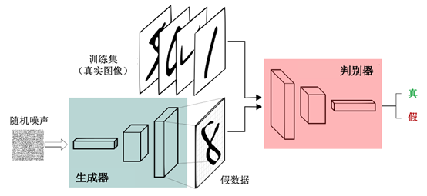
GANs (Generative Adversarial Networks)
Derives from the “zero-sum game” in game theory.
Learn the distribution of data through a Generator and a Discriminator

Slide 21
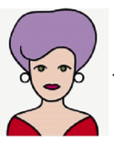
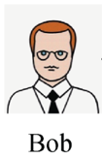
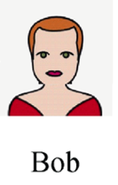
Face Forgery
Data collection
Model training
Deepfake face forgery
Alice
Bob
Alice’s body with Bob’s face

Slide 22
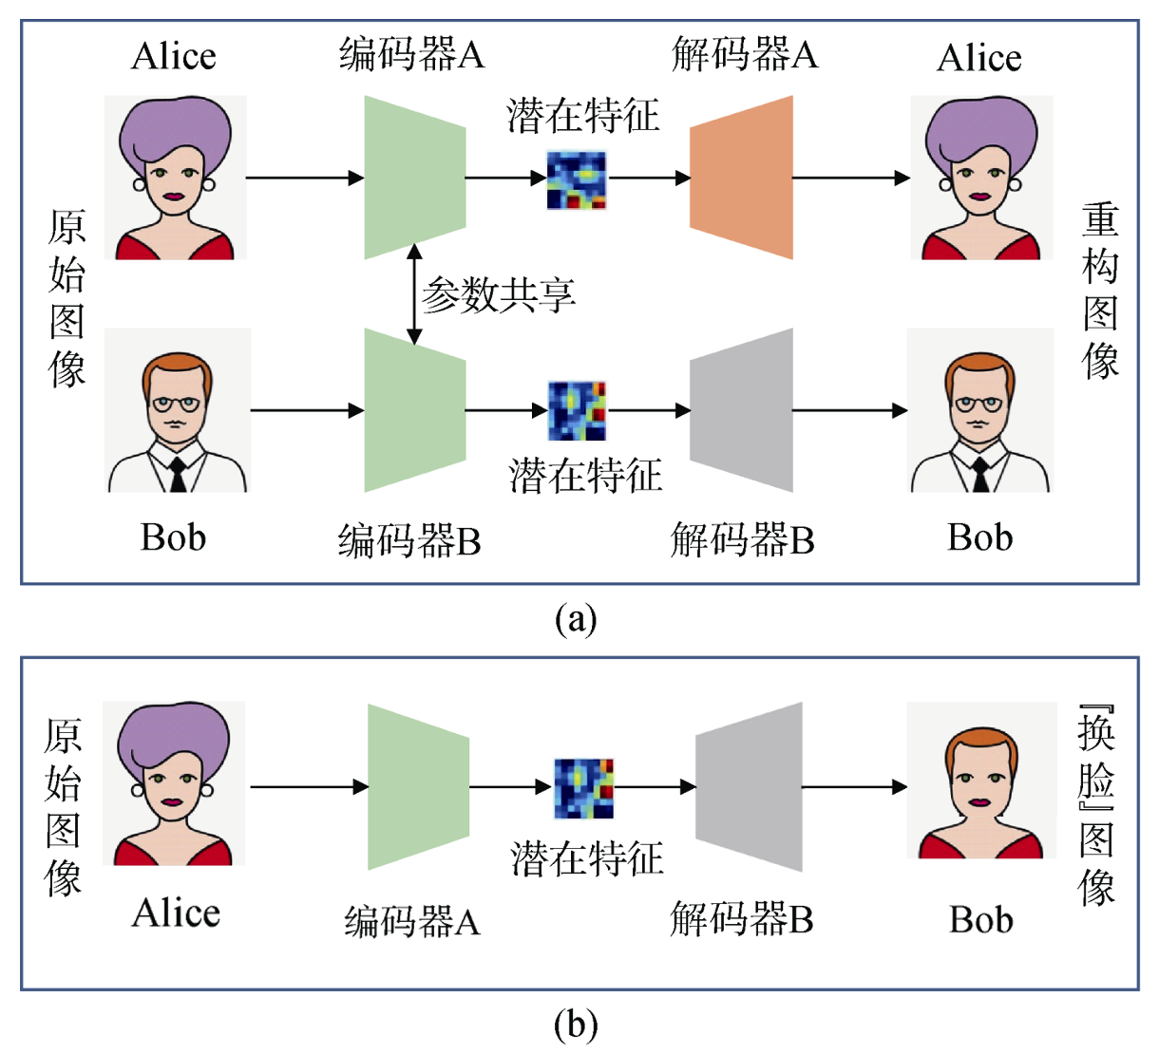
Face Forgery
Data collection
Model training
Deepfake face forgery

Slide 23
Face Forgery
Data collection
Model training
Deepfake face forgery

Slide 24
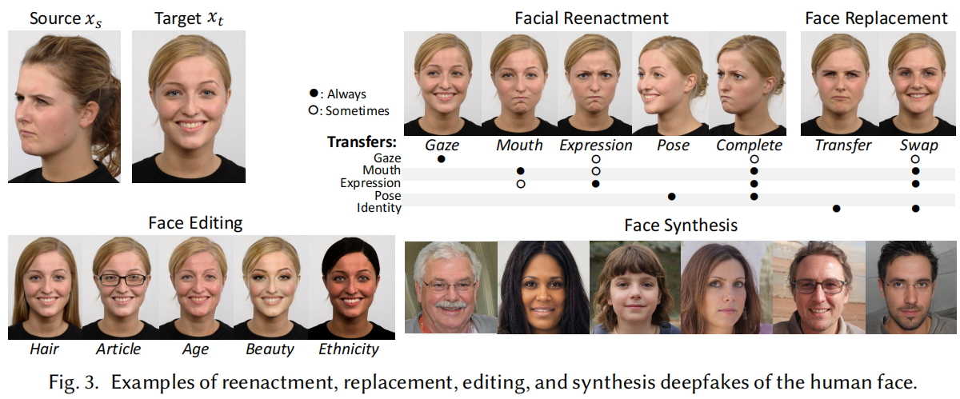
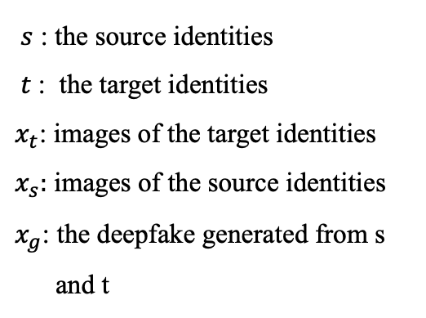
Face Forgery
Reenactment (人脸重演)
Replacement (人脸互换)
Editing (人脸编辑)
Synthesis (人脸合成)
$s$ : the source identities
$t$: the target identities
$x_{t}$: images of the target identities
$x_{s}:$ images of the source identities
$x_{g}$: the deepfake generated from s
and t
Mirsky Y, Lee W. The creation and detection of deepfakes: A survey. ACM Computing Surveys (CSUR), 2021, 54(1): 1-41.
Notes:
Editing and synthesis do not have a clear attack goal associated with them, so we will not discuss them

Slide 25
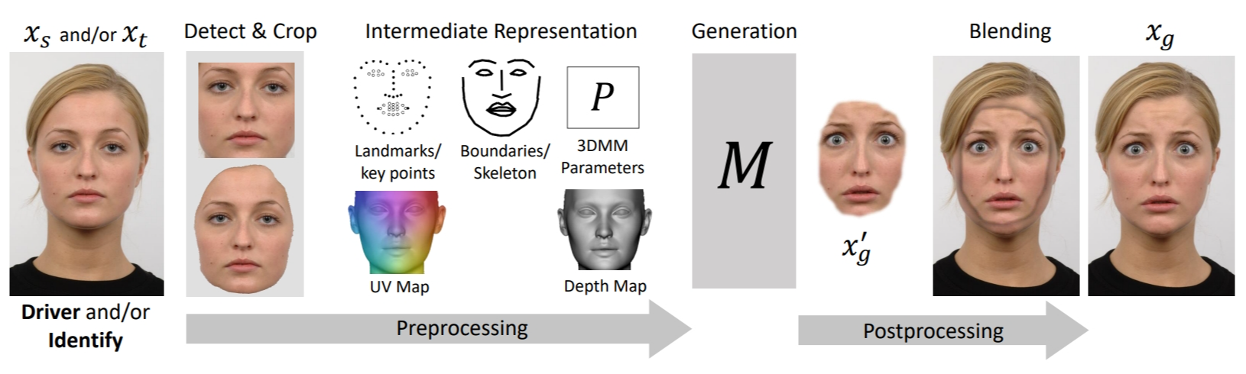
Face Forgery
STEPS：
Detects and crops the face
Extracts intermediate representations
Generates a new face based on some driving signal
Blends the generated face back into the target frame
Mirsky Y, Lee W. The creation and detection of deepfakes: A survey. ACM Computing Surveys (CSUR), 2021, 54(1): 1-41.

Slide 26
Face Reenactment
STEPS in general:
face tracking (面部追踪)
face matching (面部匹配)
face transfer (面部迁移)

Slide 27
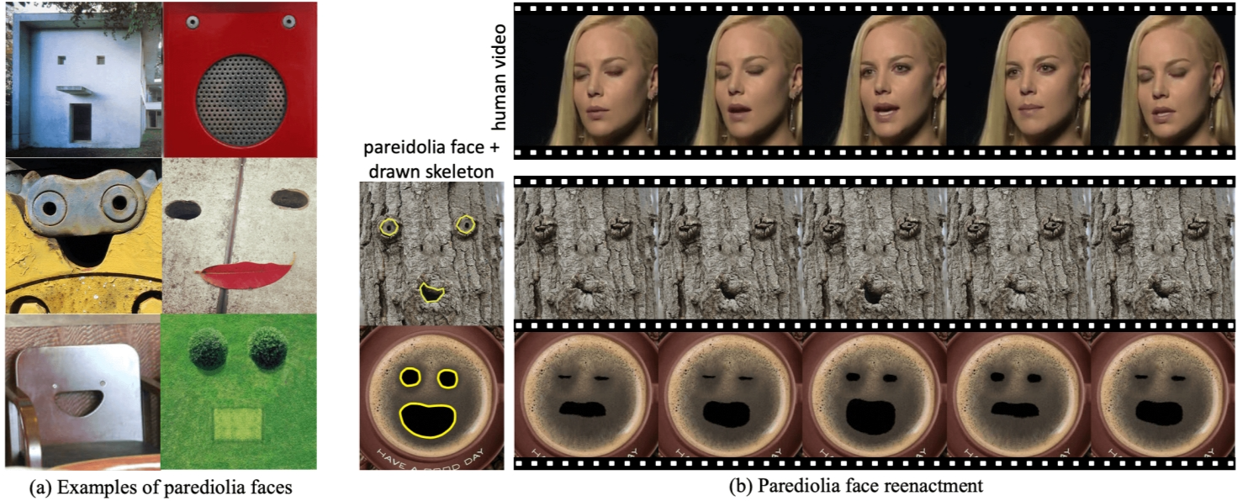
Pareidolia Face Reenactment
pareidolia face reenactment
Song, L. et al. Everything‘s talkin’: pareidolia face reenactment. CVPR, 2021.
Notes:
姜饼脸，幻想性视错觉

Slide 28
Pareidolia Face Reenactment
Challenges
1
Shape variance
The target faces are not human faces
e.g. square mouth
2
Texture variance
e.g. wood texture
Song, L. et al. Everything‘s talkin’: pareidolia face reenactment. CVPR, 2021.

Slide 29
PURA
Parametric Unsupervised Reenactment Algorithm
Parametric Shape Modeling (PSM，参数化形状建模)
Expansionary Motion Transfer (EMT，扩展运动迁移)
Unsupervised Texture Synthesizer (UTS，无监督纹理合成器)
Song, L. et al. Everything‘s talkin’: pareidolia face reenactment. CVPR, 2021.

Slide 30
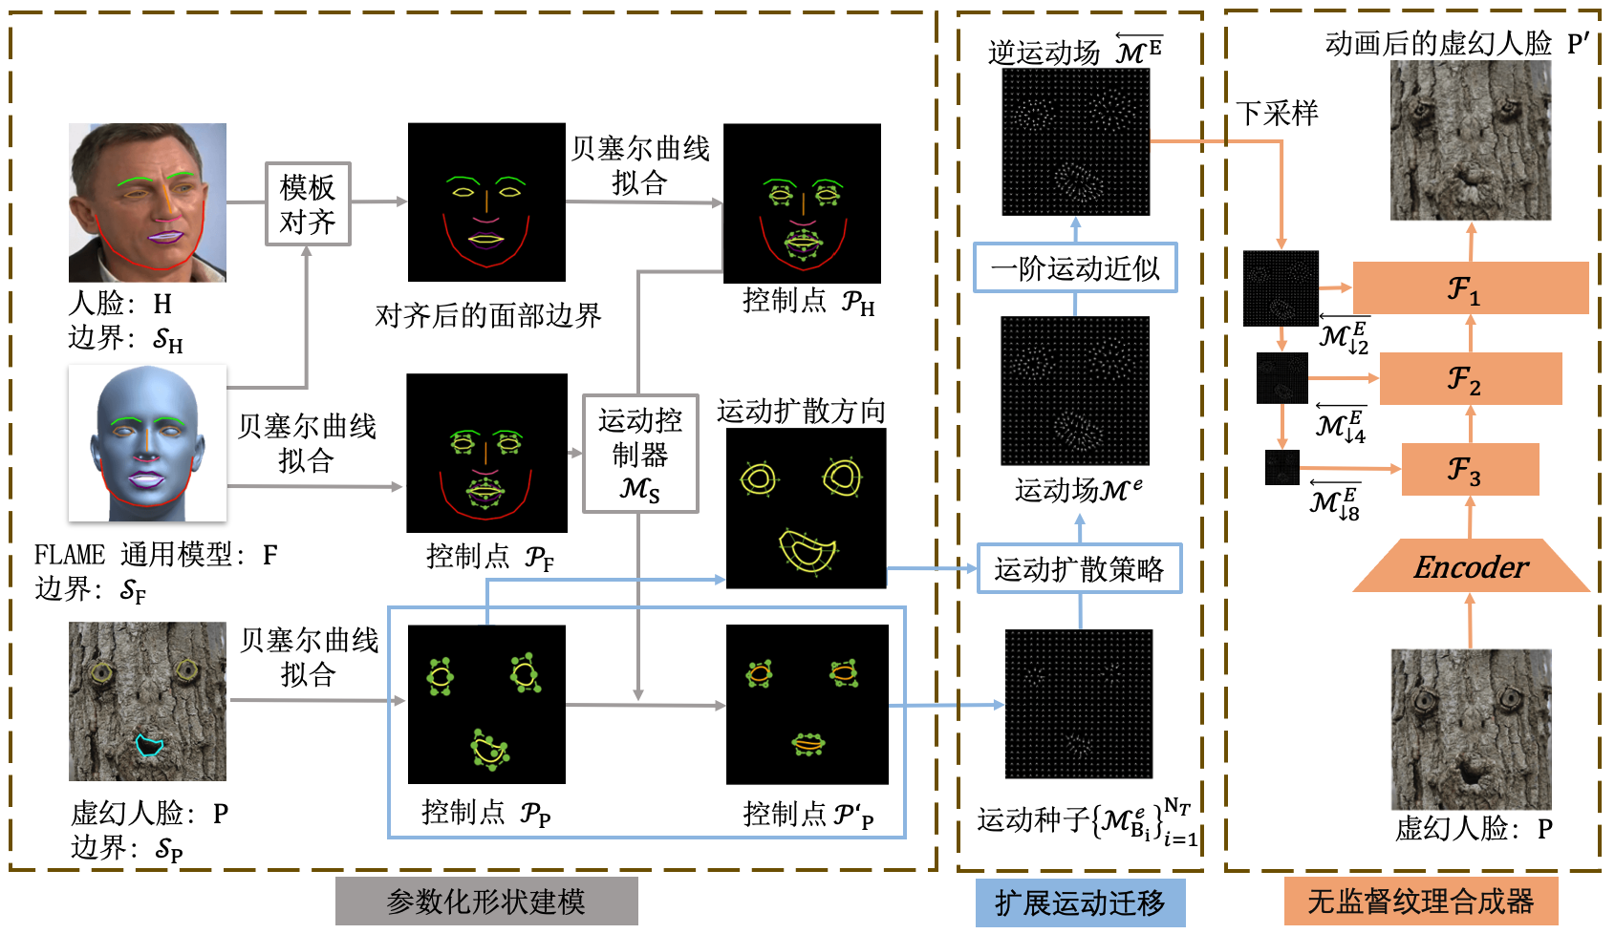
PURA
Parametric Unsupervised Reenactment Algorithm
Song, L. et al. Everything‘s talkin’: pareidolia face reenactment. CVPR, 2021.
Notes:
贝塞尔曲线是插值方程（就像所有曲线一样），这表示它们取一系列的点，生成一些处于这些点之间的值。

Slide 31
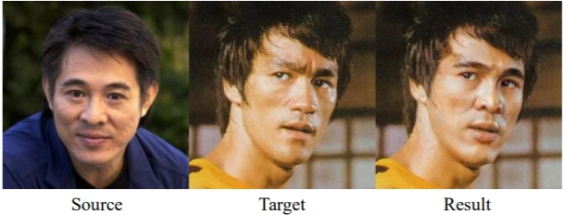
Face Replacement | Simswap
High Fidelity Face Swapping
ID Injection Module (IIM)
(身份注入模块)
❌lack the ability to generalize to arbitrary identity
❌fail to preserve attributes like facial expression and gaze direction
Weak Feature Matching Loss
(弱特征匹配损失)
Chen, R. et al. Simswap: an efficient framework for high fidelity face swapping. ACM MM, 2021.

Slide 32
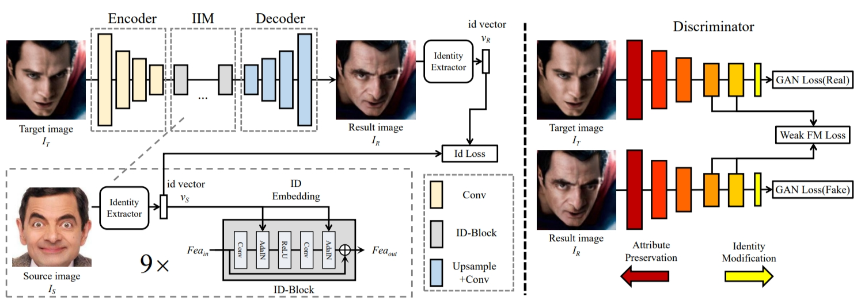
Face Replacement | Simswap
High Fidelity Face Swapping
Chen, R., et al. Simswap: an efficient framework for high fidelity face swapping. ACM MM, 2020

Slide 33
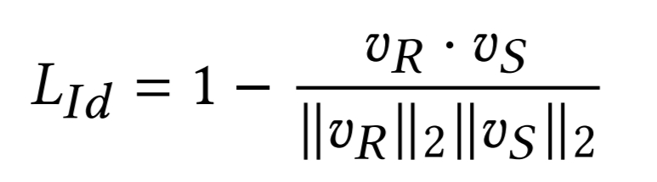
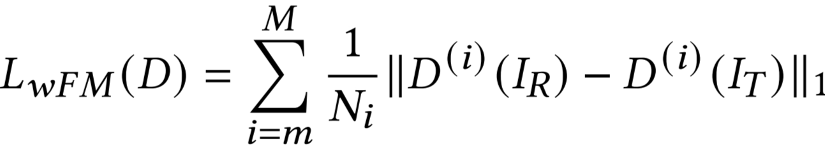
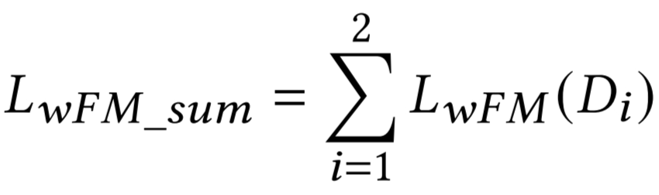
Face Replacement | Simswap
Identity Loss
Weak Feature Matching Loss
Chen, R., et al. Simswap: an efficient framework for high fidelity face swapping. ACM MM, 2020

Slide 34
This Week
General Tampering
Deepfake
Deepfake Videos
Detection

Slide 35

Deepfake Videos
More dimensions:
Timing information
The relative position of different subjects and objects
Audio fakes

Slide 36

Deepfake Videos
Challenges
How to generate reasonable gestures
How to generate a fake video in high resolution
How to generate high-quality long videos

Slide 37
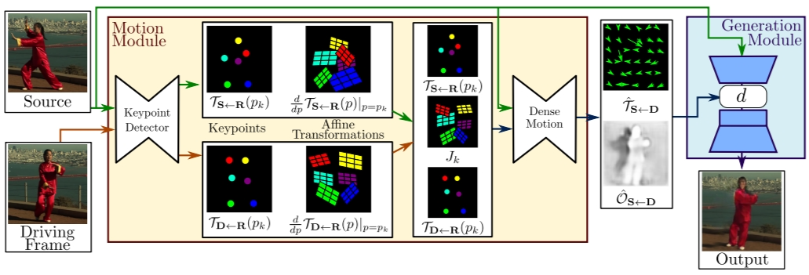
Reasonable Gestures
First-order-motion Model
Siarohin, A. et al. First order motion model for image animation. NeurIPS, 2-19.

Slide 38
Reasonable Gestures
Motion Estimation Module
Use a set of learned key points and their affine transformations to predict dense motion
Siarohin, A. et al. First order motion model for image animation. NeurIPS, 2019.

Slide 39
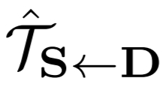
Reasonable Gestures
Generation Module
Warp the source image according to
Inpaint the image parts that are occluded in the source image.
Siarohin, A. et al. First order motion model for image animation. NeurIPS, 2019.

Slide 40
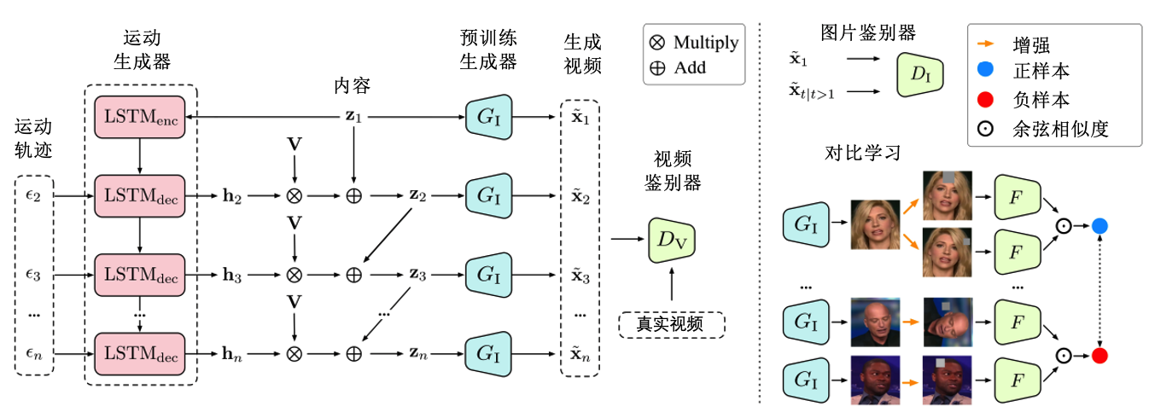
High Resolution
MoCoGAN-HD
Tian, Y., et al. A good image generator is what you need for high-resolution video synthesis. ICLR, 2022.

Slide 41
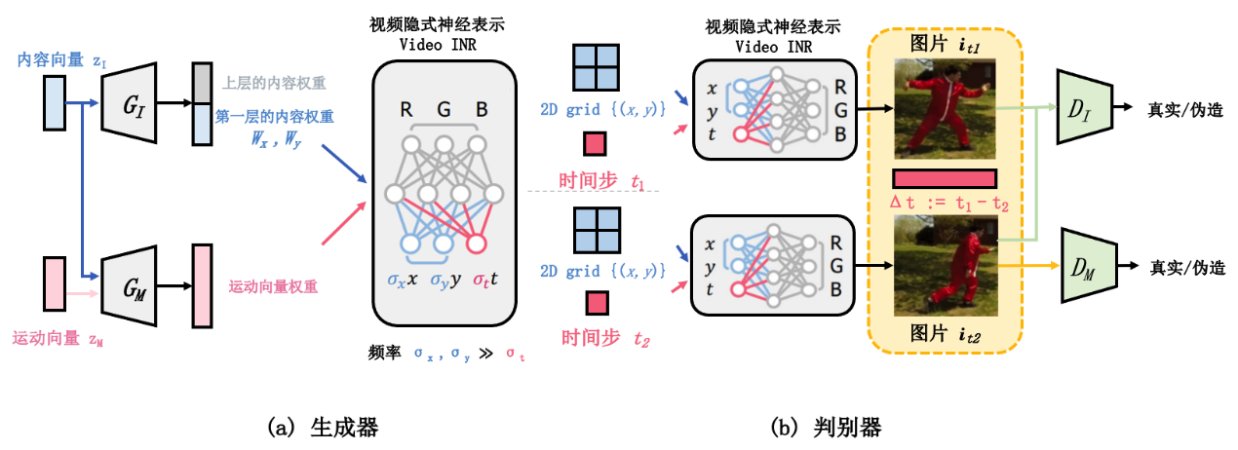
High-quality Long Videos
DIGAN
Yu, S. et al. Generating videos with dynamics-aware implicit generative adversarial networks. arXiv preprint arXiv:2202.10571.
Notes:
we found that the recent emerging paradigm of implicit neural representations (INRs) that encodes a continuous signal into a parameterized neural network effectively mitigates the issue

Slide 42
This Week
General Tampering
Deepfake
Deepfake Videos
Detection

Slide 43

Tampering Detection
Features & Semantics
Taxonomy:
General Tampering Detection——whether an ordinary object in an image has been tampered with
Deepfake Detection——whether the part of the face in the image has been tampered with

Slide 44
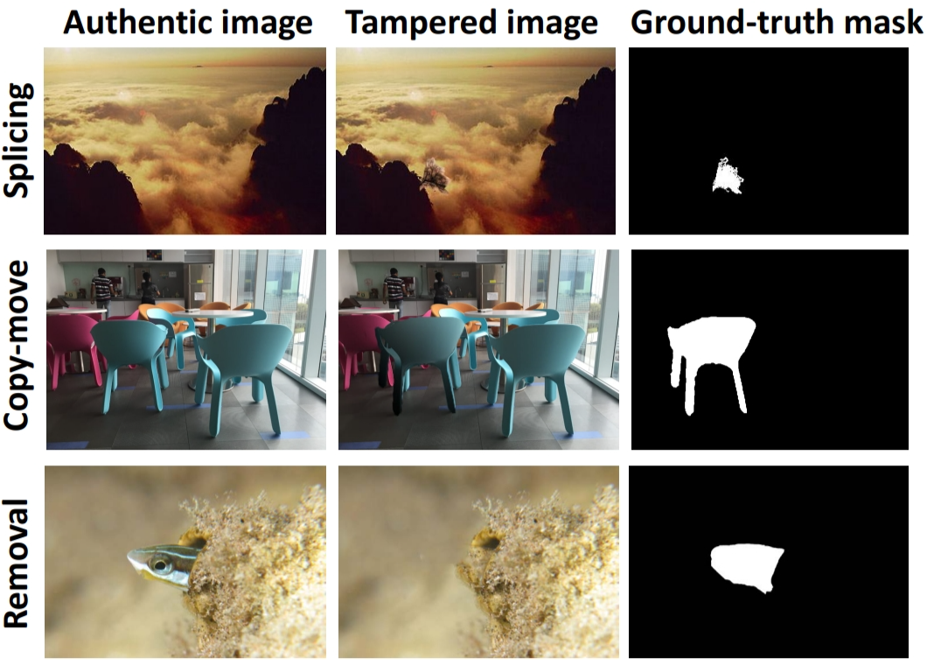
General Tampering Detection
Existing general tampering detection methods mainly focus on splicing, copy-move and removal

Slide 45

General Tampering Detection
Early detection methods
The correlation between pixels introduced during camera imaging (LCA, …)
Image Tampering
The frequency-domain or statistical features of the image and the noise it contains (PRNU)

Slide 46
General Tampering Detection
Copy-move Detection Methods
Block-based region duplication
Divide an image into many equal-size blocks, and if duplicated regions exist in the image, there should be duplicated blocks as well. Compare the blocks. (Pixel values, Statistical measures, Frequency coefficients, Moment invariants, …)
Keypoint-based region duplication
Concentrate on a few keypoints within an image so the computation cost can be significantly reduced. (SIFT, SURF)

Slide 47
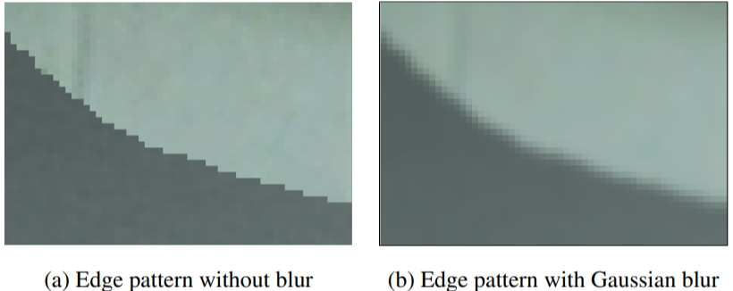
General Tampering Detection
Splicing Detection Methods
Edge anomaly
Region anomaly: JPEG compression
Region anomaly: lighting inconsistency
Region anomaly: inconsistences of camera traces

Slide 48
General Tampering Detection
Removal Detection Methods
Blurring artifacts by diffusion-based tampering
Block duplication by exemplar-based tampering

Slide 49
General Tampering Detection
Later detection methods (DL)
Median filtering forensics + CNN (Chen et al., 2015)
RGB-N (Zhou et al., 2018)
SPAN, spatial pyramid attention network (Hu et al., 2020)
Mantra-Net (Wu et al., 2019)
PSCC-Net, progressive spatio-channel correlation network (Liu et al., 2022)

Slide 50
Countermeasures
Detection
Prevention
Mirsky Y, Lee W. The creation and detection of deepfakes: A survey. ACM Computing Surveys, 2021, 54(1): 1-41.

Slide 51
Detection | Artifact-specific
Deepfakes often generate artifacts which may be subtle to humans, but can be easily detected using machine learning and forensic analysis.
Blending (spatial)
Environment (spatial)
Forensics (spatial)
Behavior (temporal)
Physiology (temporal)
Synchronization (temporal)
Coherence (temporal)
Mirsky Y, Lee W. The creation and detection of deepfakes: A survey. ACM Computing Surveys, 2021, 54(1): 1-41.

Slide 52
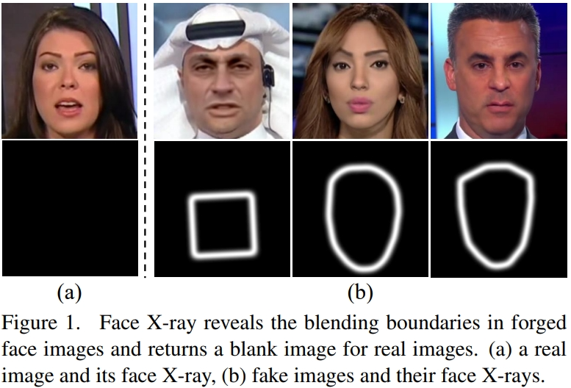
Blending
Trained a CNN to predict an image’s blending boundary and a label (real or fake)
Lingzhi Li, et al. Face x-ray for more general face forgery detection. CVPR, 2020.

Slide 53
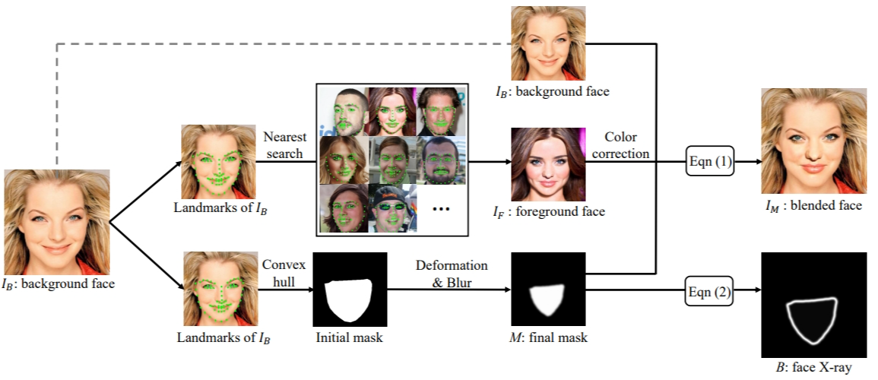
Blending
Splice similar faces found through facial landmark similarity to generate a dataset of face swaps.
Overview of generating a training sample
Lingzhi Li, et al. Face x-ray for more general face forgery detection. CVPR, 2020.

Slide 54
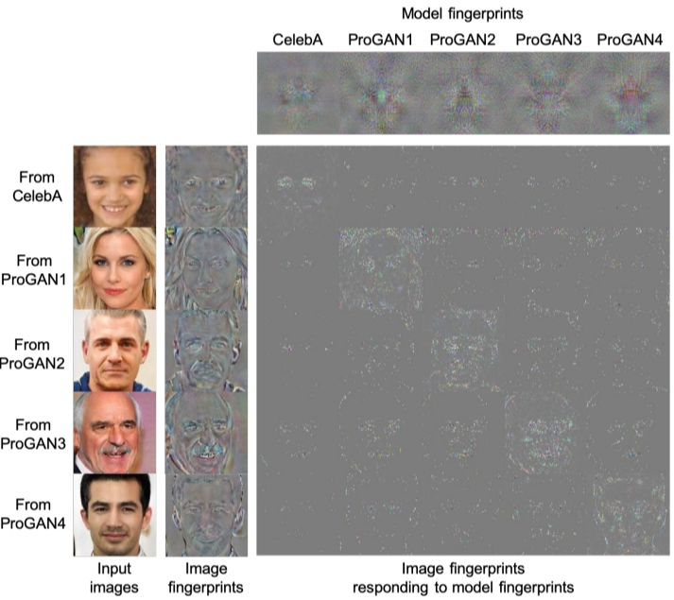
Forensics
Detect deepfakes by analyzing subtle features and patterns left by the model.
GANs leave unique fingerprints
It is possible to classify the generator given the content, even in the presence of compression and noise
Ning Yu et al. Attributing fake images to GANs: Learning and analyzing GAN fingerprints. ICCV, 2019.

Slide 55
Detection | Undirected Approaches
Train deep neural networks as generic classifiers, and let the network decide which features to analyze.
Classification
Anomaly Detection

Slide 56
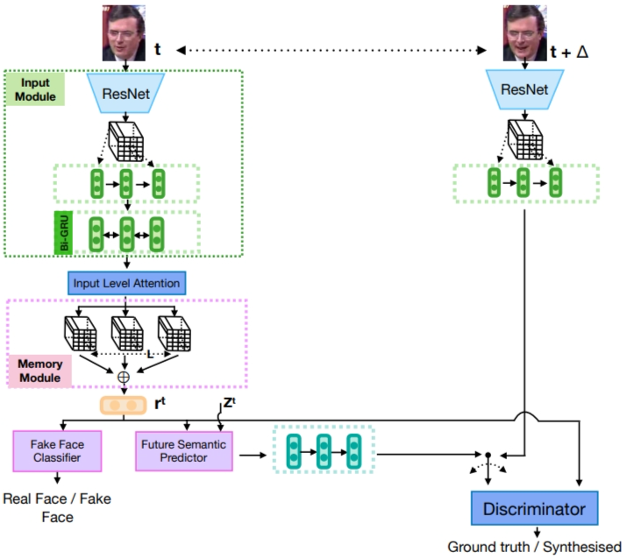

Classification
Hierarchical Memory Network (HMN) architecture
Tharindu F., et al. Exploiting Human Social Cognition for the Detection of Fake and Fraudulent Faces via Memory Networks. arXiv:1911.07844.
Notes:
We proposea Hierarchical Memory Network(HMN) architecture, which is ableto successfully detect faked faces by utilising knowledge stored in neural memories as well as visual cue store as on about the perceived face and anticipate its future semantic embeddings.This renders a generalisable face tampering detection framework.

Slide 57

Anomaly Detection
anomaly detection models are trained on the normal data and then detect outliers during deployment.
Monitor neuron behaviors(coverage) to spot AI-synthesized fake faces.
Obtain a stronger signal from than just using the raw pixels.
Is able to overcome noise and other distortions.
Run Wang et al. Fakespotter: A simple baseline for spotting ai-synthesized fake faces. arXiv:1909.06122.

Slide 58

Detection | Summary
Mirsky Y, Lee W. The creation and detection of deepfakes: A survey. ACM Computing Surveys, 2021.

Slide 59

Detection | Summary
Mirsky Y, Lee W. The creation and detection of deepfakes: A survey. ACM Computing Surveys, 2021.

Slide 60
Prevention & Mitigation
Data provenance(数据溯源)
Data provenance of multimedia should be tracked through distributed ledgers and blockchain networks.(Fraga-Lamas et al., 2019)
The content should be ranked by participants and AI.(Chen et al., 2019.)
The content should authenticated and managed as a global file system over Etherium start contracts.(Hasan et al., 2019)
Counter attacks(反击)
Adversarial machine learning

Slide 61

Adversarial machine learning
Use designed imperceptible adversarial perturbations to reduce the quality of the detected faces.
Yuezun Li, et al. Hiding Faces in Plain Sight: Disrupting AI Face Synthesis with Adversarial Perturbations. arXiv:1906.09288.

Slide 62

Crux in Deepfake Detection
Generalization of different dataset: Models trained on one dataset perform poorly on other datasets

Slide 63


Crux in Deepfake Detection
Existing datasets: There are common problems such as obvious visual defects and insufficient diversity
The detection method can easily achieve high detection accuracy after training and testing on existing datasets, but its performance is poor on high-quality falsified data.

Slide 64

High-quality Deepfake Dataset
SR-DF Dataset:
1. Use SOTA methods to generate deepfake images:
First-order-motion [Aliaksandr Siarohin, NIPS 2019 ] (2) IcFace [Soumya Tripathy, WACV 2020] (3) FSGAN [Yuval Nirkin, ICCV 2019] (4). FaceShifter [Lingzhi Li, Arxiv].
2. Post-processing： DoveNet [Cong Wenyan et al. CVPR 2020.]

Slide 65


Open-source Tools
https://github.com/wangjk666/PyDeepFakeDet

Slide 66


Open-source Tools
https://github.com/wangjk666/PyDeepFakeDet

Slide 67
谢谢！

